Slide 1
CSE 110
Aminul Huq
aminul.huq@bracu.ac.bd

Slide 2
Please join google classroom using the following code
ny5pixr

Slide 3
Scanner Class
You can use the Scanner class for console input and output.
Java uses System.out to refer to the standard output device and System.in to the standard input device.
By default the output device is the display monitor, and the input device is the keyboard.
Console input is not directly supported in Java, but you can use the Scanner class to create an object to read input from System.in, as follows:
Scanner input = new Scanner(System.in);

Slide 4
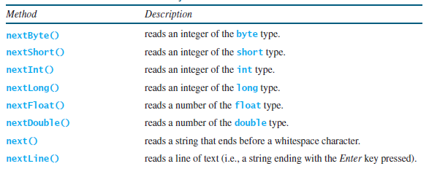
Input
The whole line Scanner input = new Scanner(System.in) creates a Scanner object and assigns its reference to the variable input. An object may invoke its methods.

Slide 5
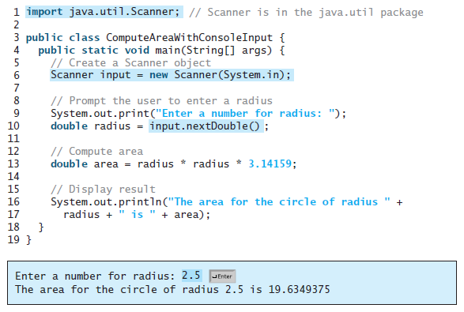

Slide 6

Formatting Console Output
If you wish to display only two digits after the decimal point in a floating-point value, you may write the code like this:

Slide 7
Formatting Console Output
However, a better way to accomplish this task is to format the output using the printf method. The syntax to invoke this method is
System.out.printf(format, item1, item2, ..., itemk)
where format is a string that may consist of substrings and format specifiers.

Slide 8
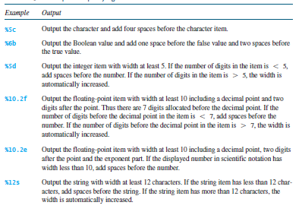
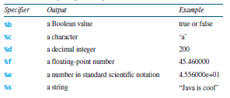
Formatting Console Output

Slide 9
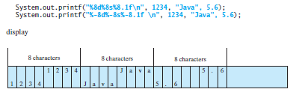
Justification
By default, the output is right justified. You can put the minus sign (-) in the specifier to
specify that the item is left justified in the output within the specified field. For example, the
following statements

Slide 10
Relational Operators

Slide 11
Control Statements
If you enter a negative value for radius the program prints an invalid result. If the radius is negative, you don’t want the program to compute the area. How can you deal with this situation?
Like all high-level programming languages, Java provides selection statements or control statements that let you choose actions with two or more alternative courses.

Slide 12
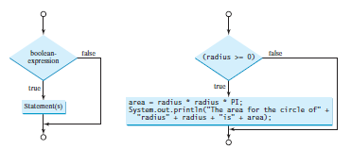
If Statement
Java has several types of selection statements:
one-way if statements, two-way if statements, nested if statements, switch statements and conditional expressions.

Slide 13
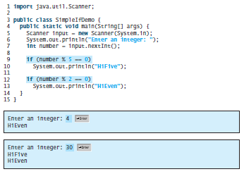

Slide 14
The ? Operator
Java includes a special ternary (three-way) operator that can replace certain types of if-then-else statements.
This operator is the ?. It can seem somewhat confusing at first, but the ? can be used very effectively once mastered. The ? has this general form: expression1 ? expression2 : expression3 Here, expression1 can be any expression that evaluates to a boolean value. If expression1 is true, then expression2 is evaluated; otherwise, expression3 is evaluated.

Slide 15
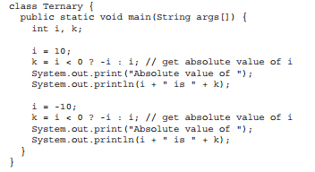

Example

Slide 16
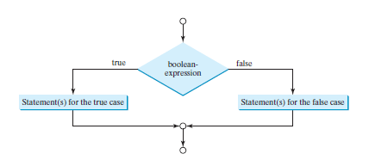

Two way if statement

Slide 17

Nested if-else
The statement in an if or if ... else statement can be any legal Java statement, including another if or if ... else statement. The inner if statement is said to be nested inside the outer if statement. The inner if statement can contain another if statement; in fact, there is no limit to the depth of the nesting.

Slide 18
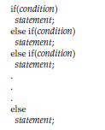
The if-else-if Ladder
A common programming construct that is based upon a sequence of nested ifs is the if-else-if ladder

Slide 19
Switch statements
The switch statement observes the following rules:
■ The switch-expression must yield a value of char, byte, short, or int type and must always be enclosed in parentheses.
■ The value1, and valueN must have the same data type as the value of the switch-expression. Note that value1, and valueN are constant expressions, meaning that they cannot contain variables, such as 1 + x.
■ When the value in a case statement matches the value of the switch-expression, the statements starting from this case are executed until either a break statement or the end of the switch statement is reached.
■ The keyword break is optional. The break statement immediately ends the switch statement.
■ The default case, which is optional, can be used to perform actions when none of the specified cases matches the switch-expression.
■ The case statements are checked in sequential order, but the order of the cases (including the default case) does not matter. However, it is good programming style to follow the logical sequence of the cases and place the default case at the end.

Slide 20
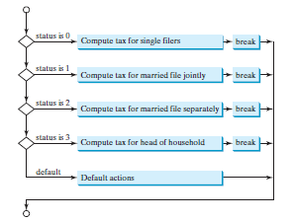
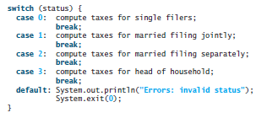
Example

Slide 21
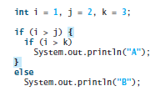
Output?

Slide 22
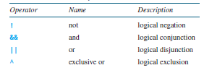
Logical Operators

Slide 23

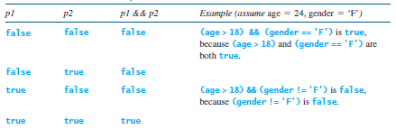
Truth Tables

Slide 24
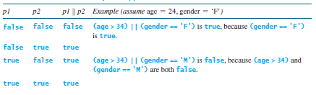
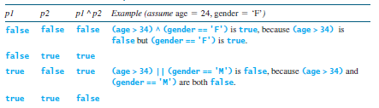
Truth Tables

